Slide 1
Mesh Network Performance
Cory Cook

Slide 2
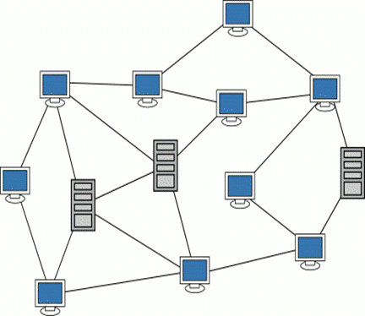
Introduction

Slide 3
GPS Addressing Scheme
x |  |  |  |  | X |  | X
 |  |  | x |  |  |  |  |  | x
 | x |  |  |  |  | X
 |  |  |  | X |  |  | X
 |  | X
 |  |  |  |  |  |  |  |  | X
x |  |  |  | X
 |  | x |  |  |  |  | X
x |  |  |  | x |  | x |  |  | X

Slide 4
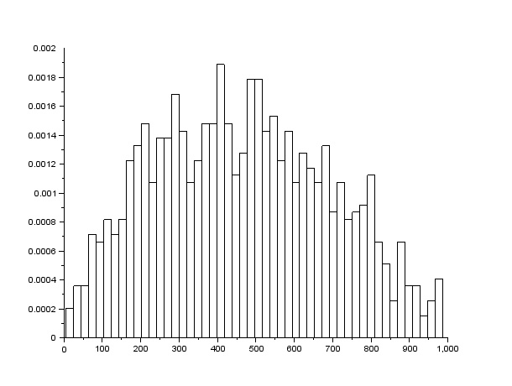
Performance: Latency

Slide 5
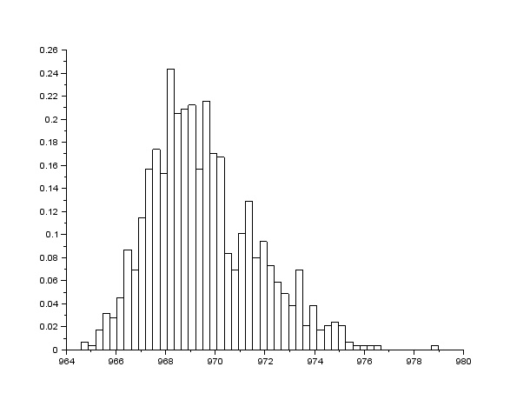
Performance: Bandwidth (Gigabit)

Slide 6
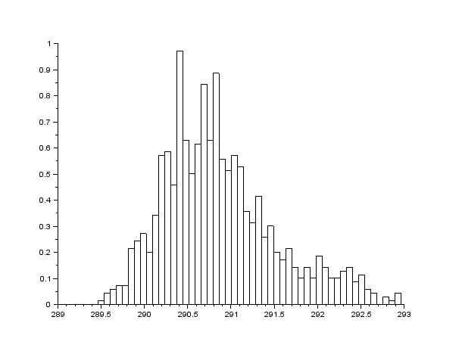
Performance: Bandwidth (300 Mbps)

Slide 7
Comparison
 | Bandwidth | Latency
Cable ISP | 30 Mbps (ISP) | ~20ms/router
Test Mesh Network | 290 Mbps | ~500ms/8km

